Slide 1

Building Your Career With SAP Certification
Kuliah Umum STIE Perbanas Surabaya
22 Agustus 2017 by: Hanry D. Kumala, MBA

Slide 2

Today’s Agenda
Latest Economic Situation
Impacts of Economic Condition
The Latest Trends in ICT Industry
New Products Offerings by SAP
Technical Skills Needed
Career Options
Strategies to Go Abroad
Conclusions

Slide 3
Latest Economic Situation.

Slide 4
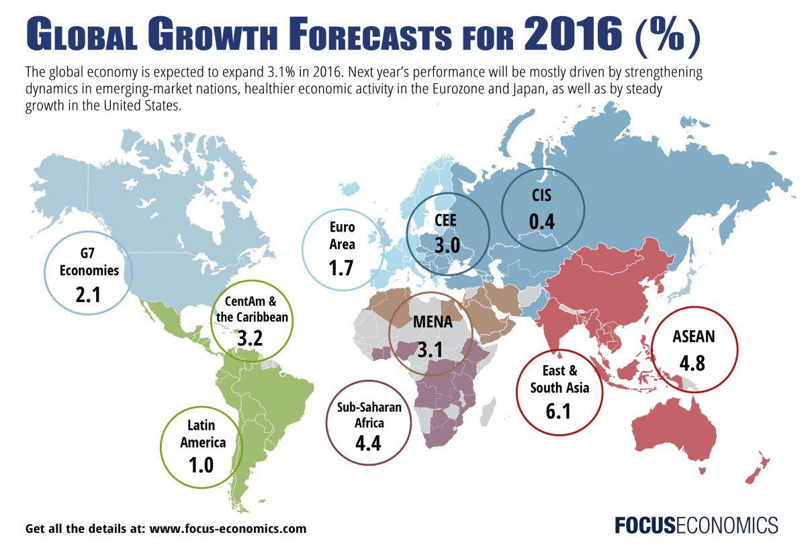
Current Economic Situation
Mostly SLOW or WEAK
Economic Growth
(Only 3.1%) !
WHY?

Slide 5
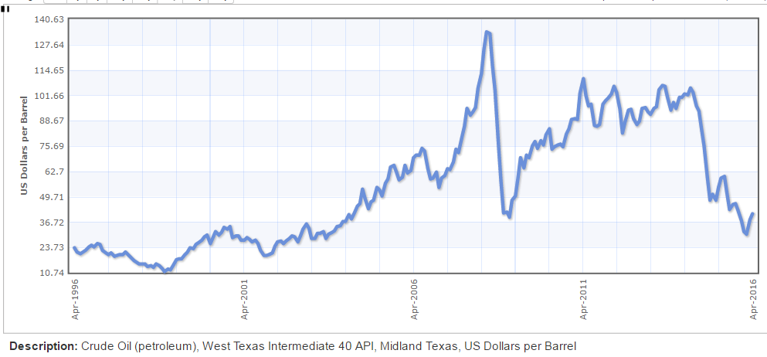
Current Economic Situation(cont’d)
For the last 10 years oil prices had been going up exponentially. US and Europe slows down due to high commodity prices. This leads to slow down in consumer pending.
Source: http://www.indexmundi.com

Slide 6
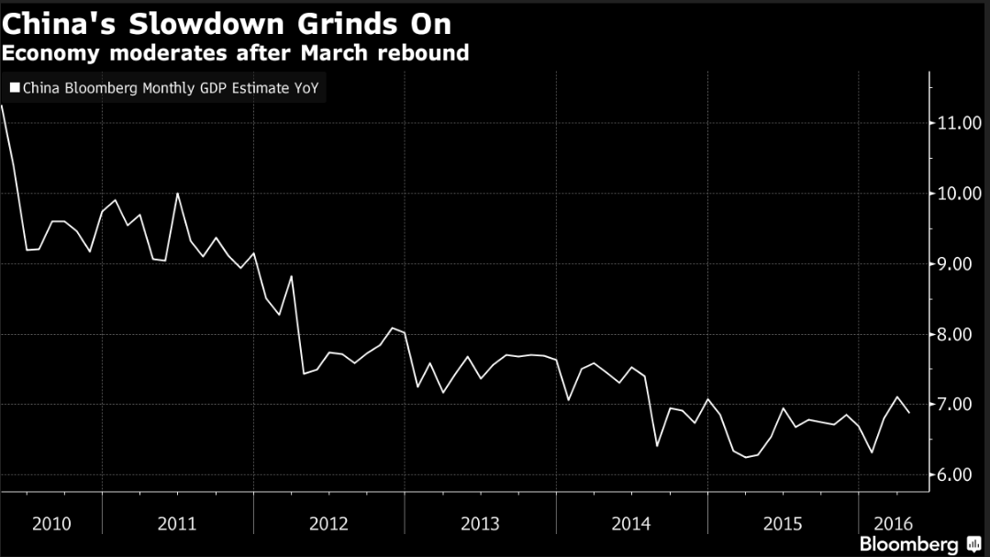
Current Economic Situation(cont’d)
As the world’s manufacturing country, China started to experience reduced orders for goods.

Slide 7
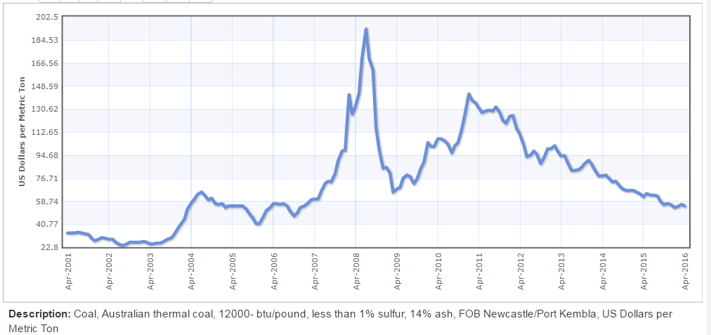
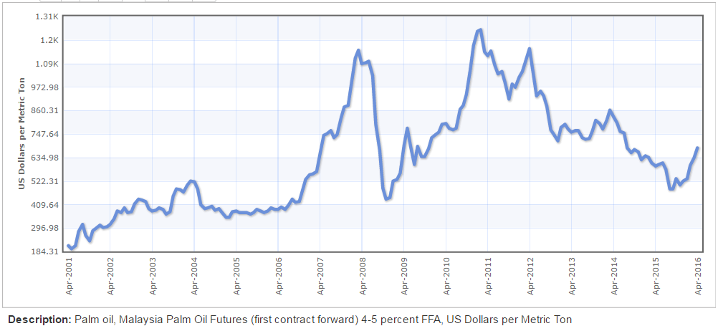
Current Economic Situation(cont’d)
Countries that rely mostly on commodity such as Indonesia, Malaysia and Middle East countries suffer economic slow down. Indonesia as one of the largest Palm Oil, Coal and Rubber producer especially hit hard.
Coal Price
Palm Oil
Source: http://www.indexmundi.com

Slide 8
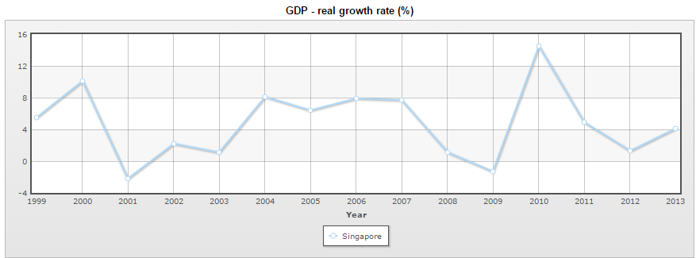
Current Economic Situation(cont’d)
Countries that rely mostly on investment from China such as Singapore also feeling the impact.
Source: http://www.indexmundi.com

Slide 9
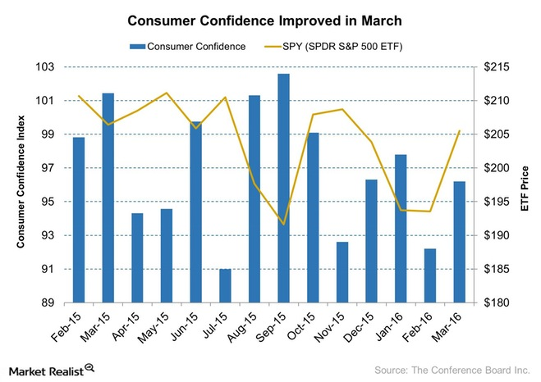
Current Economic Situation(cont’d)
The US economy has been improving, thus many experts hope the US shall drive the global economic recovery.

Slide 10
Impacts of Economic Situation.

Slide 11
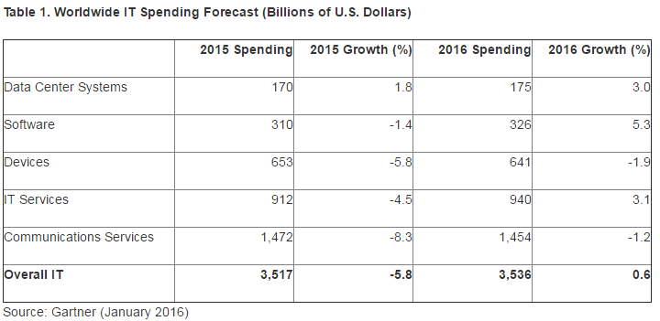
Impact of Economic Situation To ICT Industry
Software and IT Services have the highest expected growth within IT industry
(8.4% combined) !

Slide 12
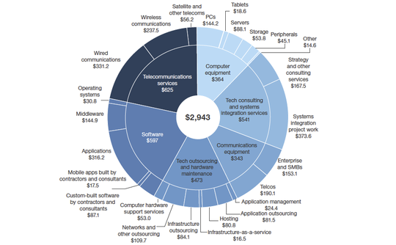
Impact of Economic Situation To ICT Industry (cont’d)
It is estimated the ICT spending in Asia region: $1.0 Trillion USD. It is the second largest spending after North America region.
Global Tech Market Will Continue To Grow At 4%-5% Rates In 2016 And 2017
Source: Forrester

Slide 13

Impact of Economic Situation To Fresh Graduates
It is a competitive job market especially for fresh graduates who have no working experience and no ICT skill.
Here are some tips needed to increase the likelihood of getting your preferred job:
There is no substitute for good grades – the best jobs usually requires the best graduates.
Know the trends in your industry, concentration, etc.
Invest in professional development – take additional trainings & certification as required by the industry.

Slide 14

Impact of Economic Situation To Fresh Graduates (cont’d)
Take up internship opportunities even though the salary is not as much as you like.
Leverage relationship with people who have already graduated and got a job.
Good organization experiences within or outside is very important to differentiate a person.
Impressive CV and Certificates differentiate you from the others, and increase the probability of being hired. Once hired, your personal attitude will differentiate you from the rest.

Slide 15
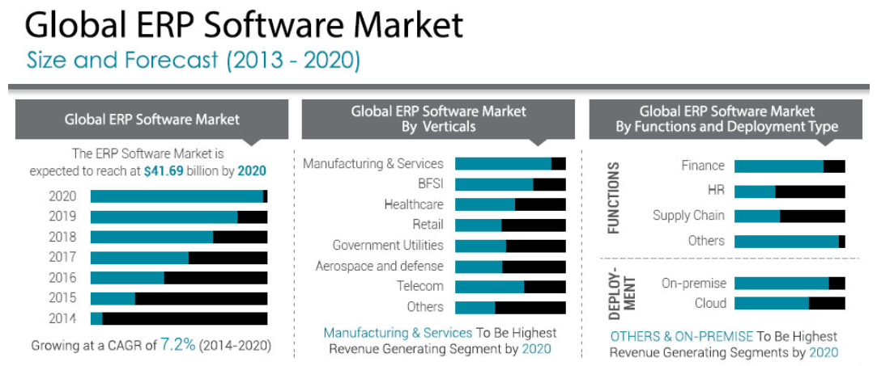
Global ERP Market
https://www.alliedmarketresearch.com

Slide 16
SAP ERP Market Share 2016
As of Q1 2016, SAP ERP has the largest market share compared to any other ERP solutions.
https://www.alliedmarketresearch.com

Slide 17
Latest Trends in ICT Industry.

Slide 18

The Latest Trends in ICT Industry (cont’d)
The Internet of Things (IoT) is the network of physical objects—devices, vehicles, buildings and other items—embedded with electronics, software, sensors, and network connectivity that enables these objects to collect and exchange data.
Big data is a term for data sets that are so large or complex that traditional data processing applications are inadequate. The term often refers simply to the use of predictive analytics or certain other advanced methods to extract value from data, and seldom to a particular size of data set.
https: Wikipedia

Slide 19
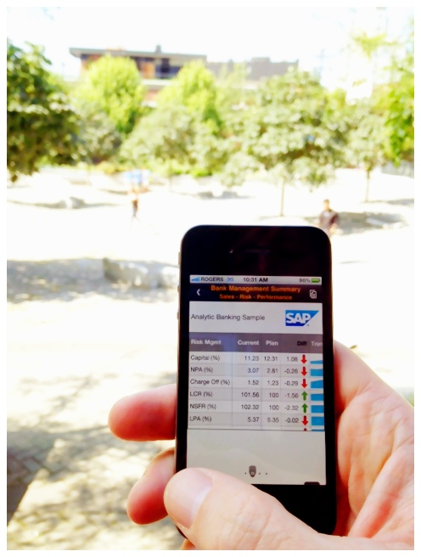
The Latest Trends in ICT Industry
Software as a service (Saas) / Cloud Computing is a software licensing and delivery model in which software is licensed on a subscription basis and is centrally hosted. It is sometimes referred to as "on-demand software".
Mobile Computing is human–computer interaction by which a computer is expected to be transported during normal usage, which allows for transmission of data, voice and video without having to be connected to a fixed physical link. Mobile computing involves mobile communication, mobile hardware, and mobile software.
https: Wikipedia

Slide 20
New SAP Product Offerings.

Slide 21
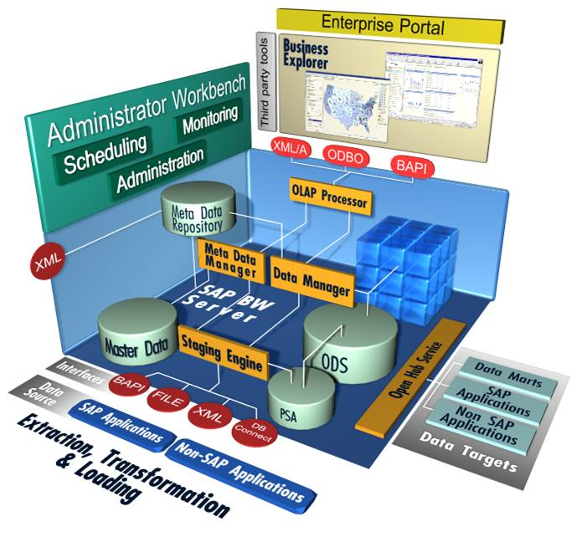
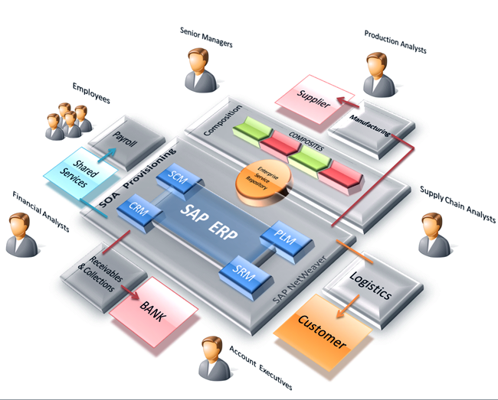


SAP Solutions for I.o.t and Big Data
SAP HANA Database – an in-memory database developed by SAP. Instead of using hard drive as storage device, it uses RAM to store all the data making it hundreds of time faster.
SAP ERP Business Suite on HANA– the market leader in ERP software now running on SAP HANA Database.
SAP BI on HANA – a business analytics software than runs on SAP HANA allowing real-time data analysis.
SAP S/4 HANA – The next generation ERP software based on SAP ERP ECC 6, running on SAP HANA database.

Slide 22
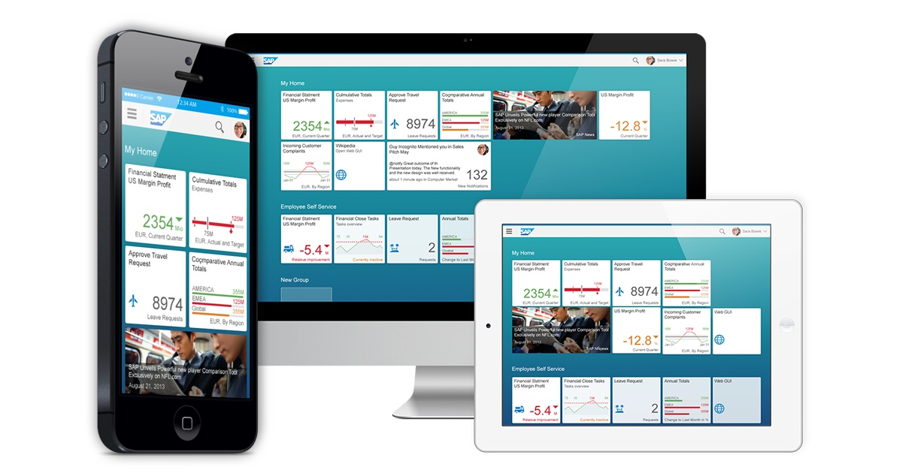
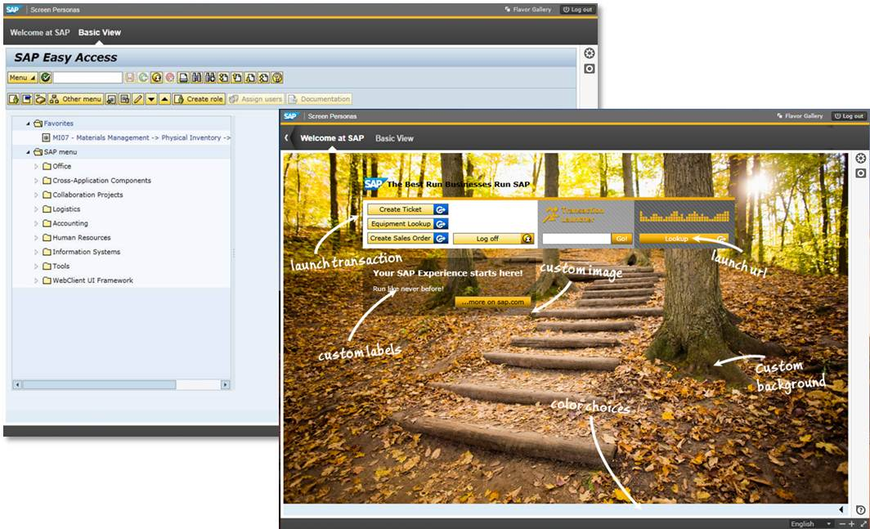
SAP Solutions for Mobile Computing
SAP Fiori is the new user experience (UX) for SAP software. SAP Fiori UX represents a personalized, responsive and simple user experience across devices and deployment options.
SAP Screen Personas provides a simple, drag and drop approach to modify many common SAP GUI screens to make them more usable as well as more visually appealing

Slide 23
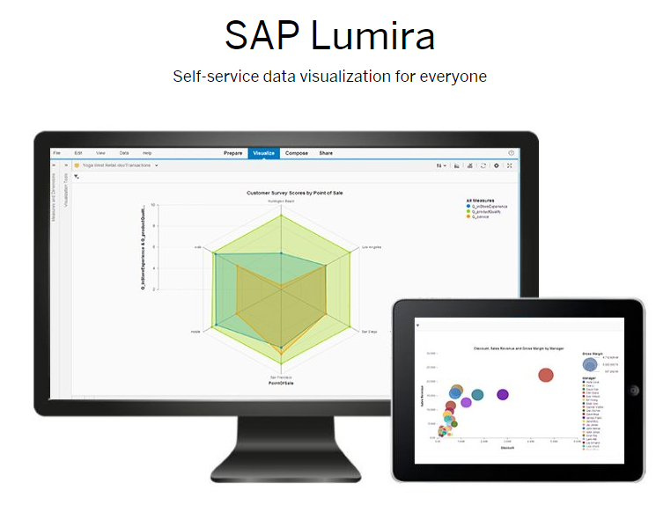
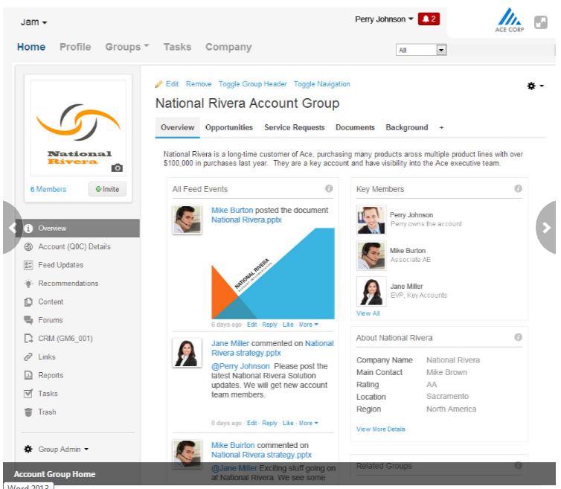
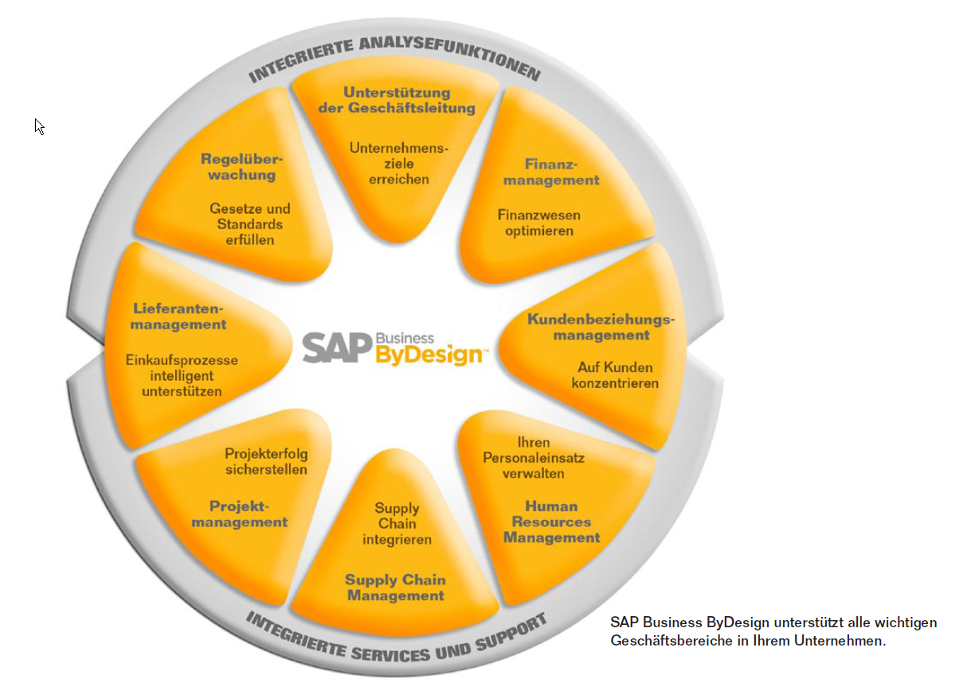
SAP Solutions for Cloud Computing
SAP Lumira is a self-service, data visualization application for business users.
SAP ByDesign is a cloud-based ERP solution targeted for mid-market companies.
SAP Jam is SAP's cloud-based social media platform. It allows employees to collaborate and share documents and ideas around a topic or goal.

Slide 24
Many Career Options for Graduates with SAP Skills

Slide 25
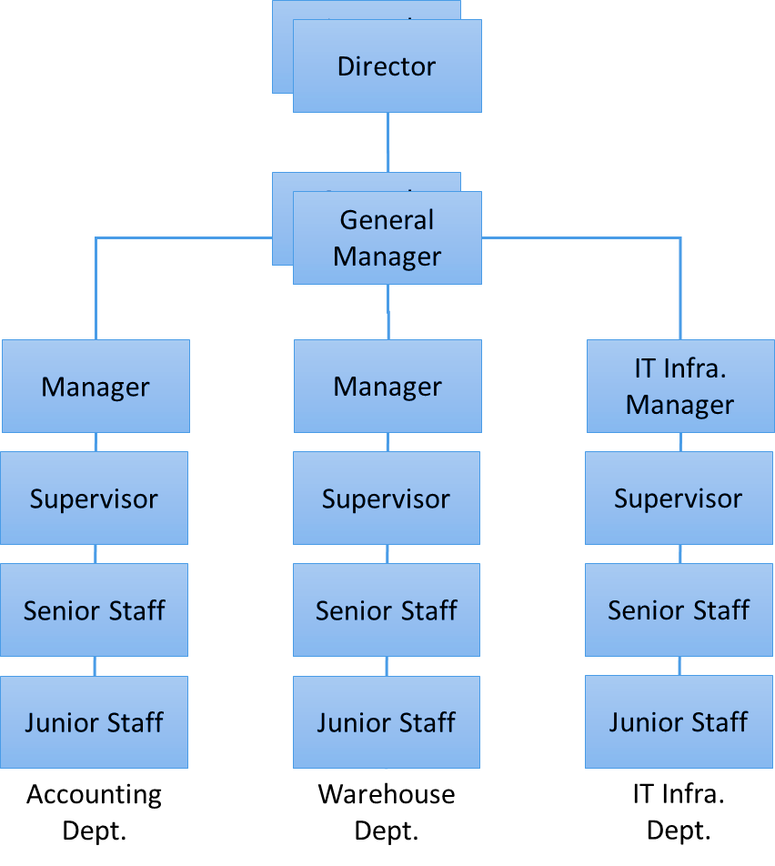

Career Options for Fresh Graduates with SAP Skills
Option 1:
Working as a business owner in a company that has not implemented SAP solution.
Required Level of Knowledge:
The business processes knowledge embedded in the SAP courses can be applied in any industry.
SAP Level of Knowledge: Level 1

Slide 26
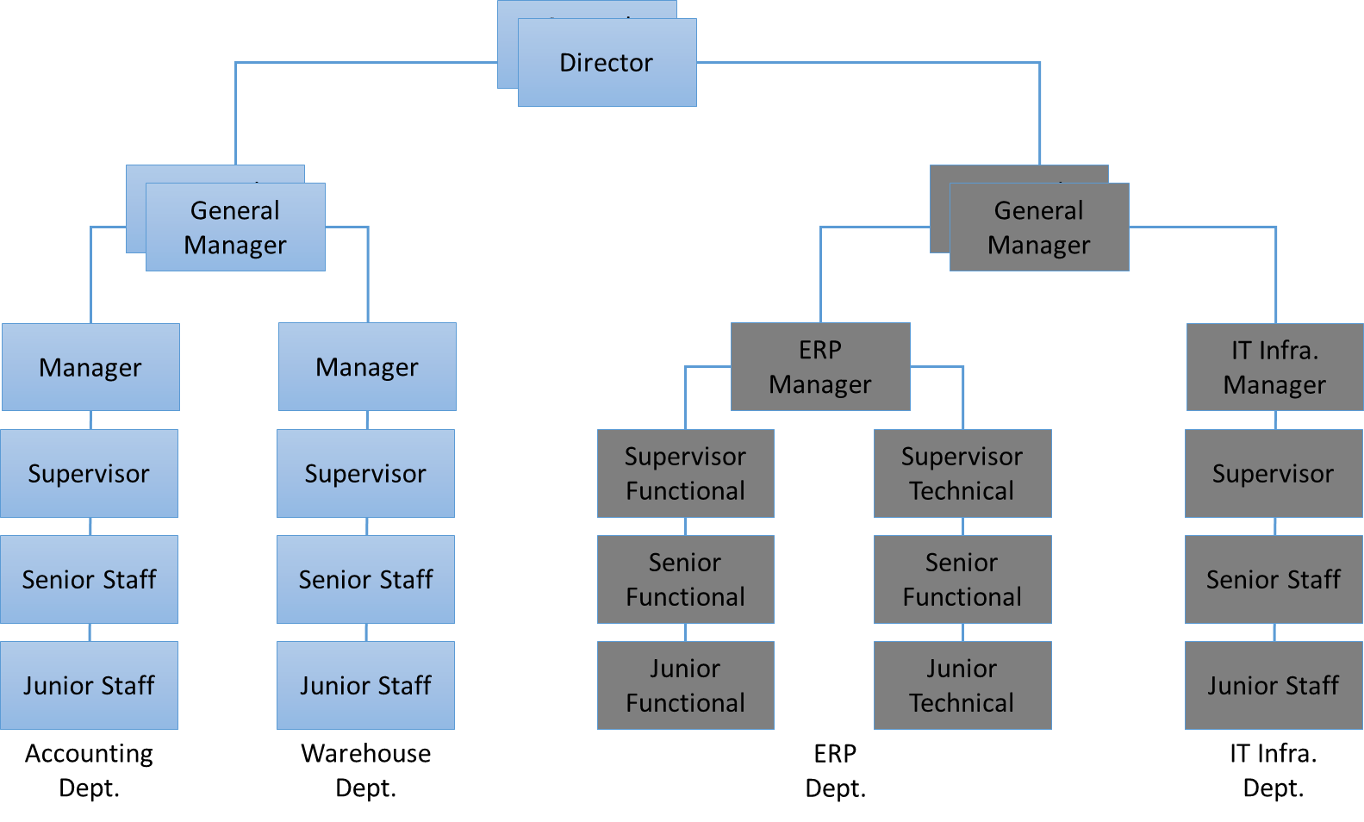
Career Options for Fresh Graduates with SAP Skills
Option 2:
Working as an SAP user in a company that has implemented SAP ERP.
Required Level of Knowledge:
The business processes and ‘how-to’ knowledge is beneficial in performing daily activities.
SAP Level of Knowledge: Level 2

Slide 27
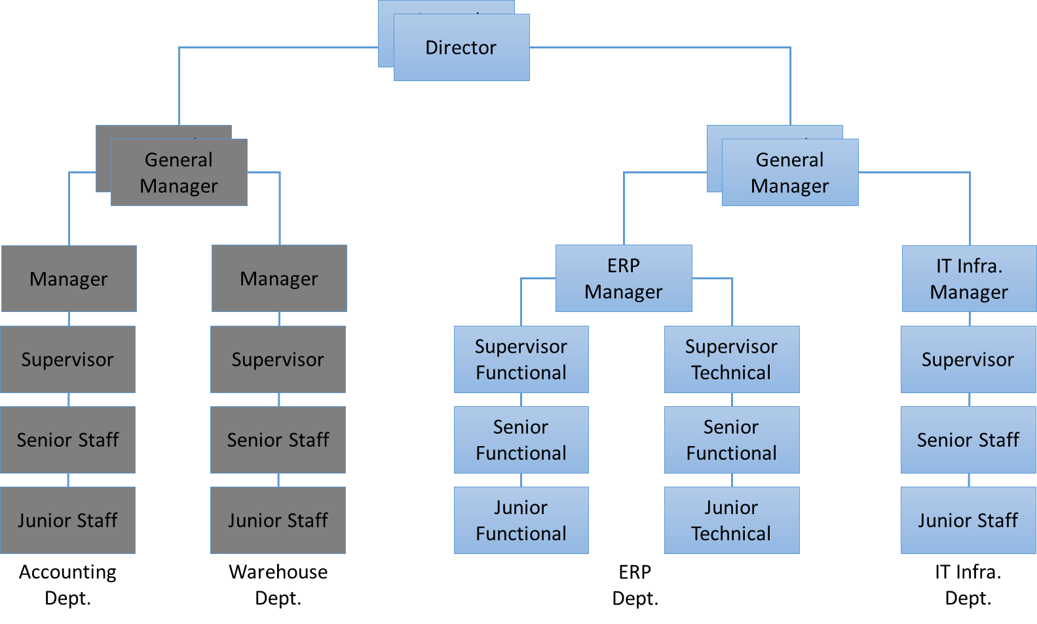
Career Options for Fresh Graduates with SAP Skills
Option 3:
Working as an internal team member in a company that has implemented or will implement an ERP software.
Required Level of Knowledge:
The business processes and ‘how-to’ knowledge is beneficial in supporting SAP users through out the company.
SAP Level of Knowledge: Level 2

Slide 28
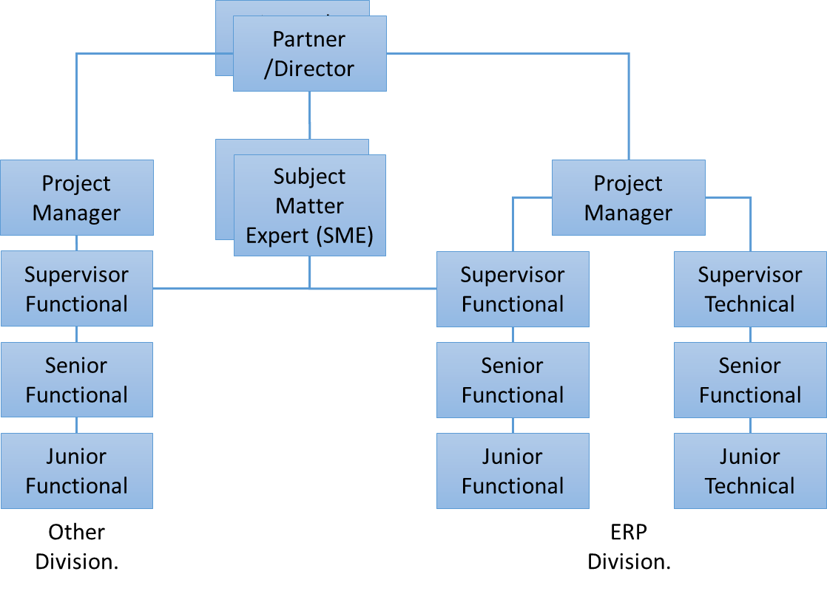
Career Options for Fresh Graduates with SAP Skills
Option 4:
Working as a consultant in a consulting company that implements an ERP software.
Required level of knowledge:
Leveraging the ‘know-how’ from the SAP courses combined with additional training in SAP configuration, shall equip an individual to become an SAP consultant.
SAP Level of Knowledge: Level 3

Slide 29
Career Options for Fresh Graduates with SAP Skills
Option 5:
A person with several years of experience in SAP implementation projects can opted to work as a freelance SAP consultant. When involved in a project, a freelancer can be part of a consulting company or company’s internal team member.
The current daily rate for a freelance consultant ranging from $150 USD to $450 USD depending on the module and engagement complexity.
In an economic down-turn, more companies prefer a free-lance consultant.
SAP Level of Knowledge: Level 3 + Solution Academy Certification

Slide 30
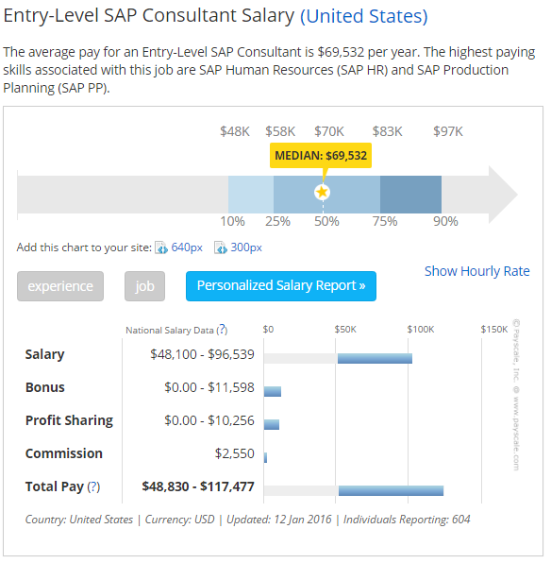
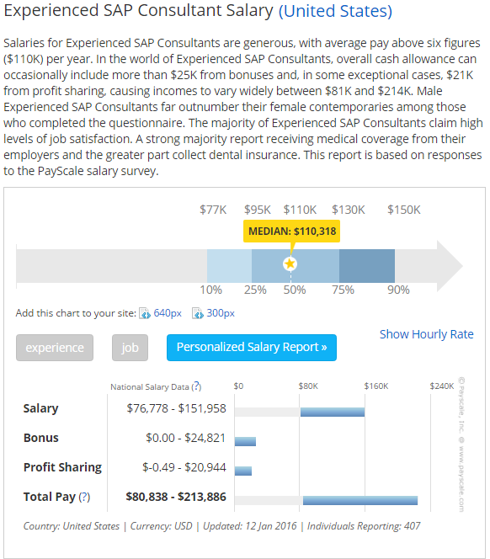
Career Options for Fresh Graduates with SAP Skills (cont’d)
http://www.payscale.com/

Slide 31
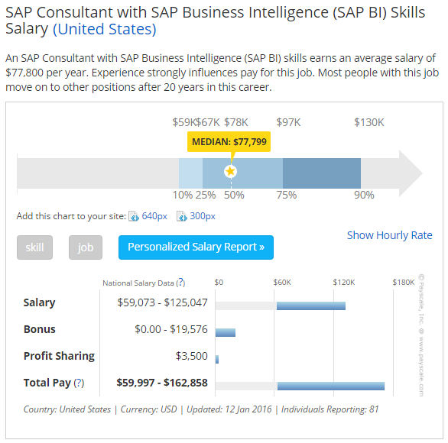
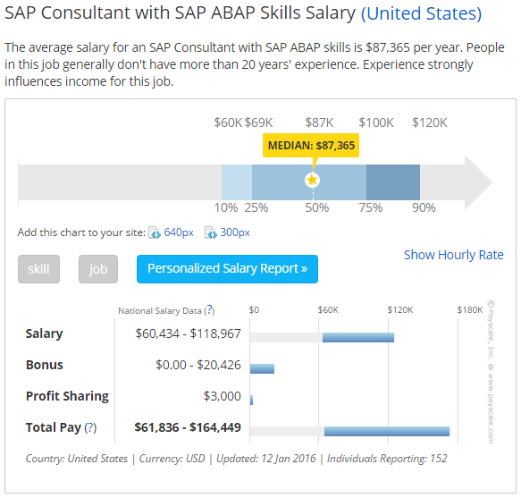
Career Options for Fresh Graduates with SAP Skills (cont’d)
http://www.payscale.com/

Slide 32







Some of International SAP Consulting Companies

Slide 33







Some of Indonesia SAP Consulting Companies

Slide 34
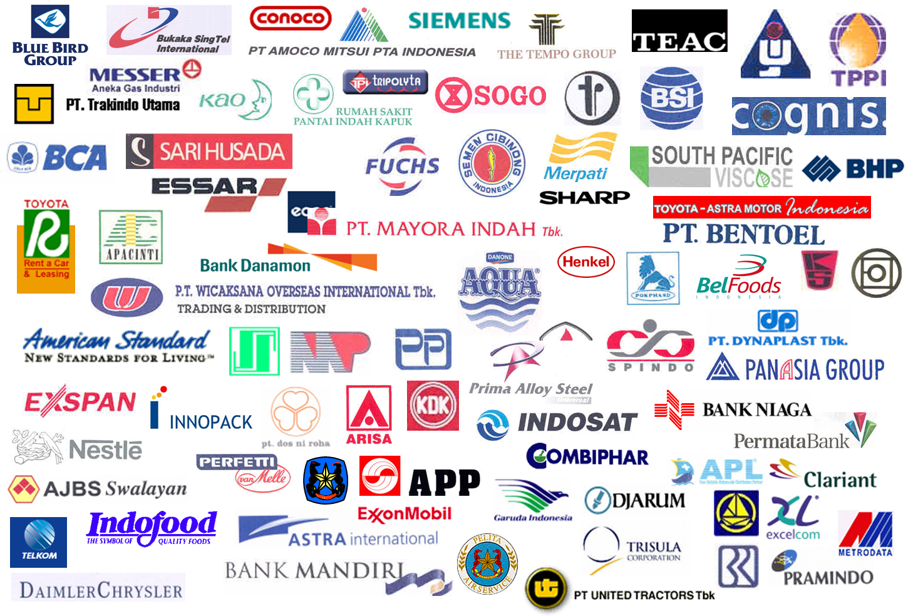

Some of Local and International Companies Who Have Implemented SAP

Slide 35

Challenges in SAP Related Career/Job
You should choose a career not because of the money, but it should because you love to be involved in what your are doing.
SAP Career is not for everybody
Frequently travel to many cities/countries/locations.
You may not know in which city you will be for the next assignments
High stress and pressure.
Must meet deadlines on daily basis, work all day until late night.
You may face rejections because of the change SAP implementation brings to the company.
ERP software in complex. Solving one issue may cause another issue in other areas.
Like any other jobs, you must have passion on what you do.

Slide 36
Technical Skills Needed.

Slide 37

Hard Skills Needed to Get the SAP Related Jobs
Best practice in business processes in areas such as: logistics, procurement, manufacturing, warehouse management, sales order management, distribution, human resource, etc.
SAP ERP ECC 6.0 Functional Modules such as Financial Accounting, Materials Management, Sales & Distribution, Human Capital Management, etc.
ABAP/4 Programming Language.
SAP Basis with SAP NetWeaver 7.4 & 7.5.

Slide 38

Hard Skills Needed to Get the SAP Related Jobs
Microsoft Excel with functions such as Pivot Table, Vlookup, Filter, If-Else Functions, etc.
Microsoft Visio for business process mapping and flowchart.
Other basic computer programs such as MS Word, MS PowerPoint, MS Outlook, etc.
Other programming languages especially Java Language, HTML5, and mobile Application development languages.

Slide 39

Soft Skills Needed to Get the SAP Related Jobs
The English Language
Analytical Skills
Communication skills
Teamwork and collaboration
Adaptability
Problem solving
Critical observation
Conflict resolution
Assertiveness
Risk Taking

Slide 40

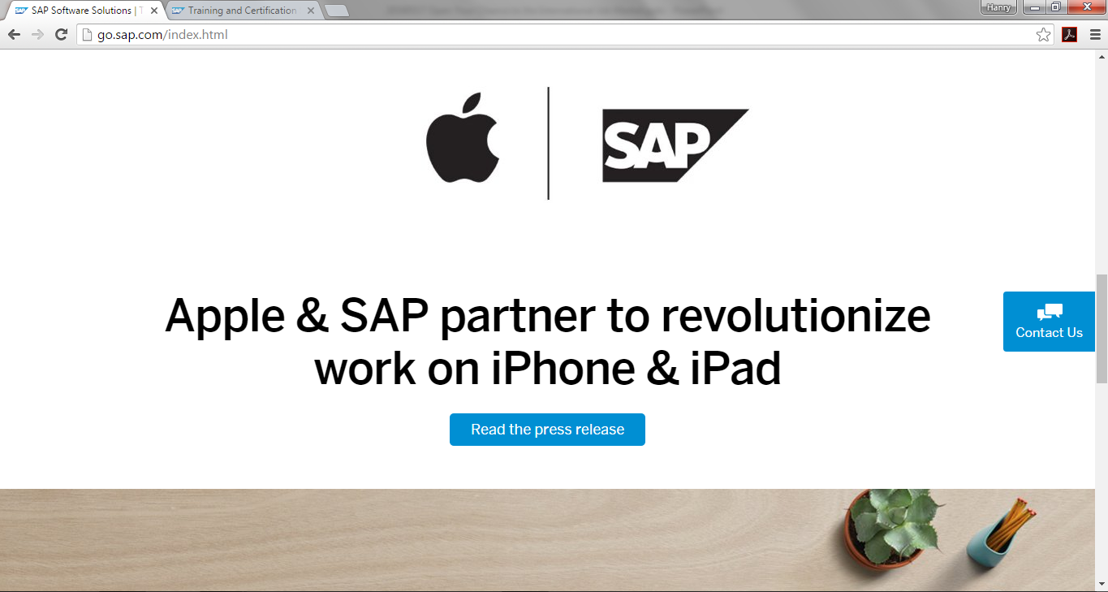
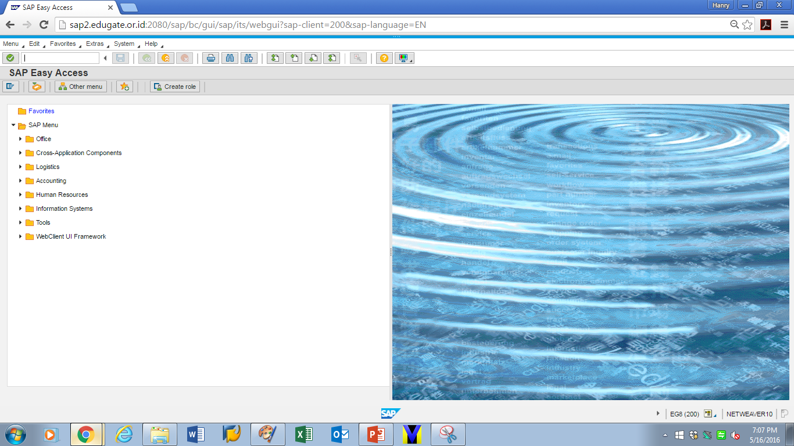
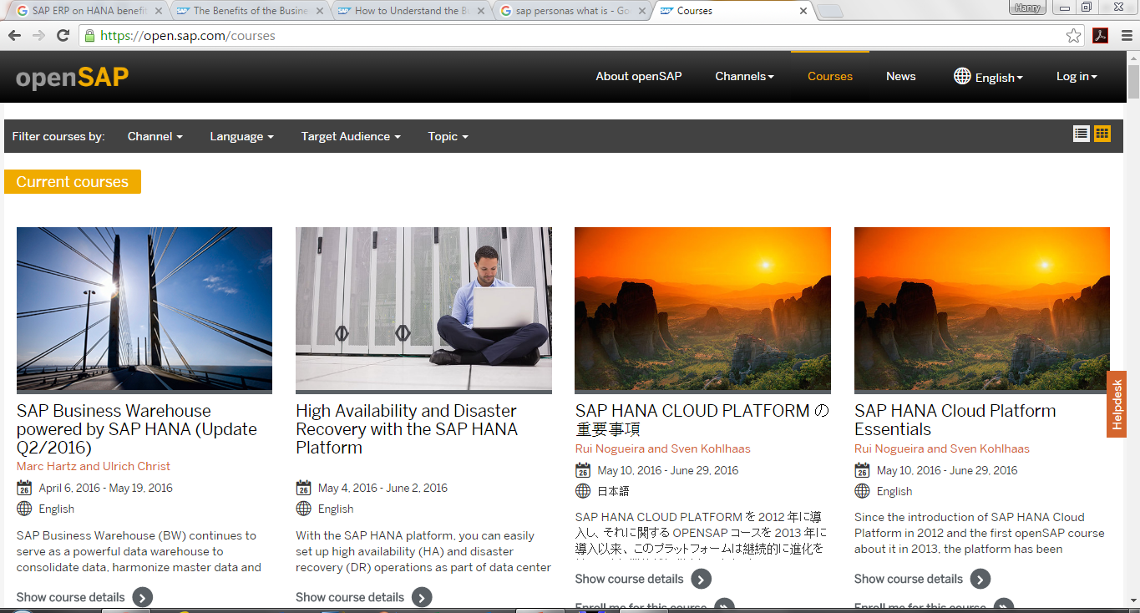
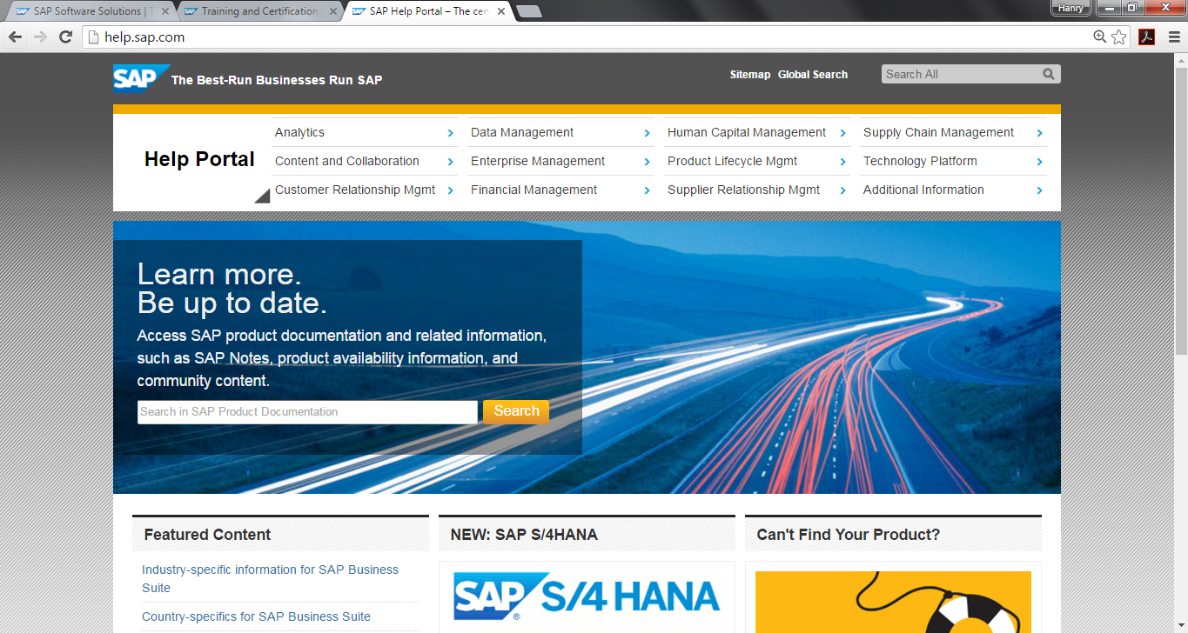
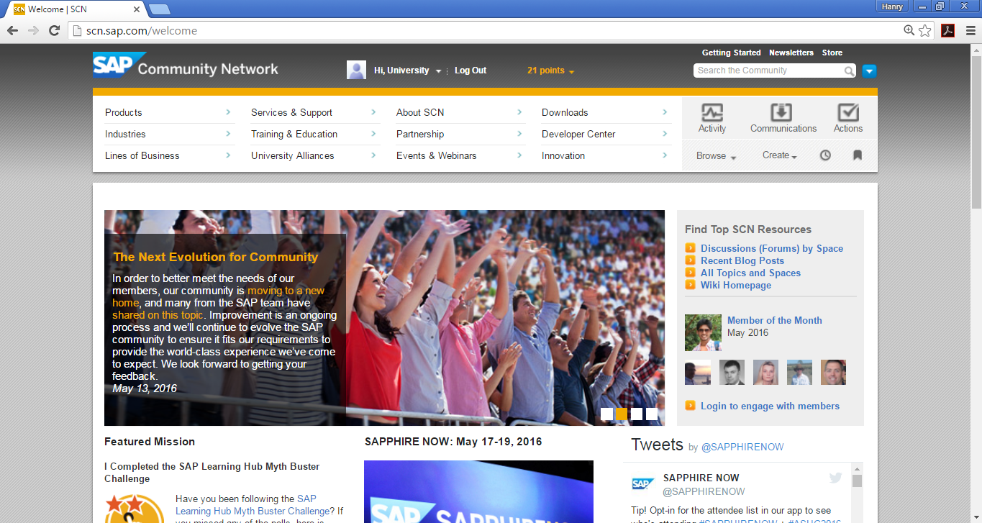
Where to Get Started with SAP Related Skills – Free of Charge
SAP website – http://www.sap.com
Edugate’s SAP ERP demo – http://www.edugate.co.id/demo
OpenSAP Courses – http://open.sap.com/courses
SAP Help – http://help.sap.com
SAP Community Network and other websites – http://scn.sap.com
And Most Importantly:
  Networking with SAP specialists

Slide 41
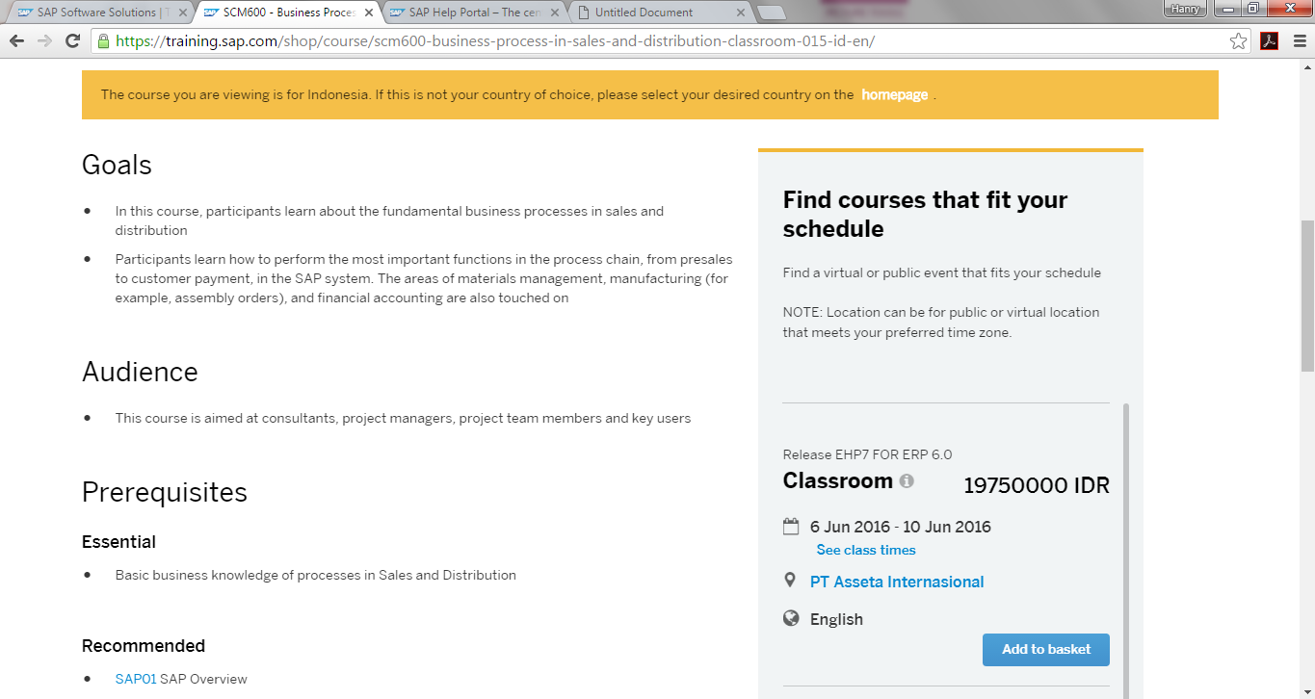
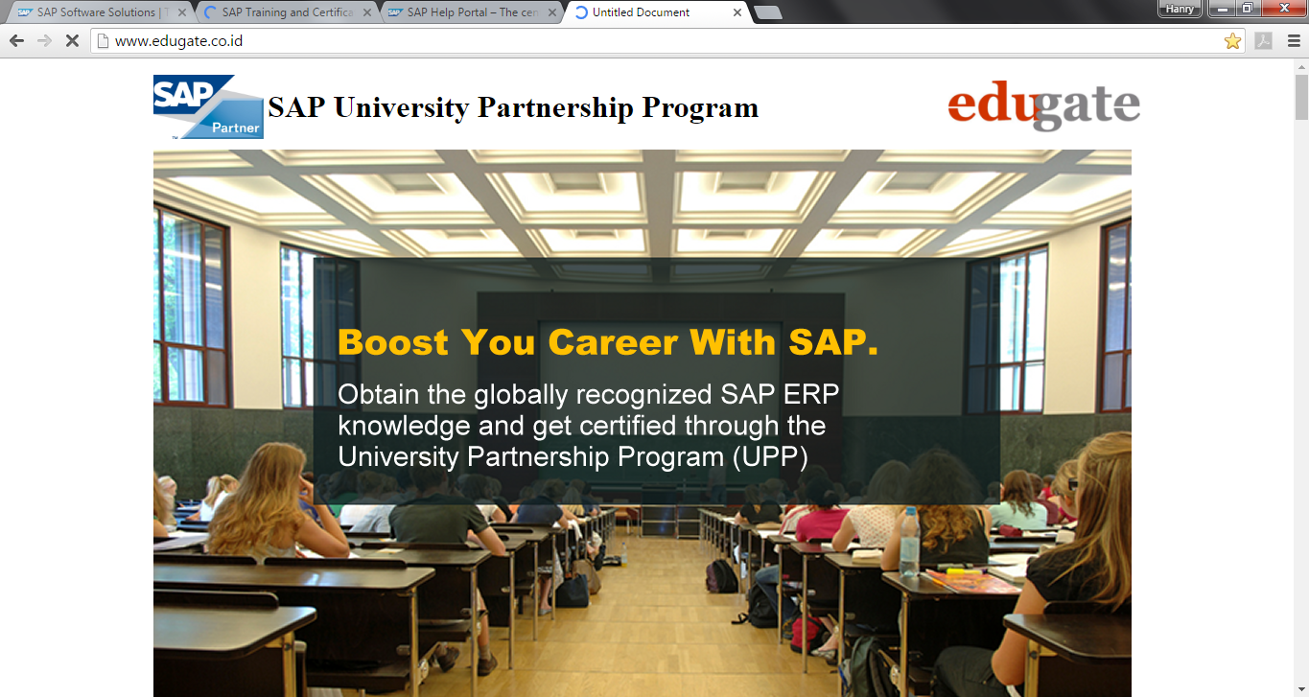
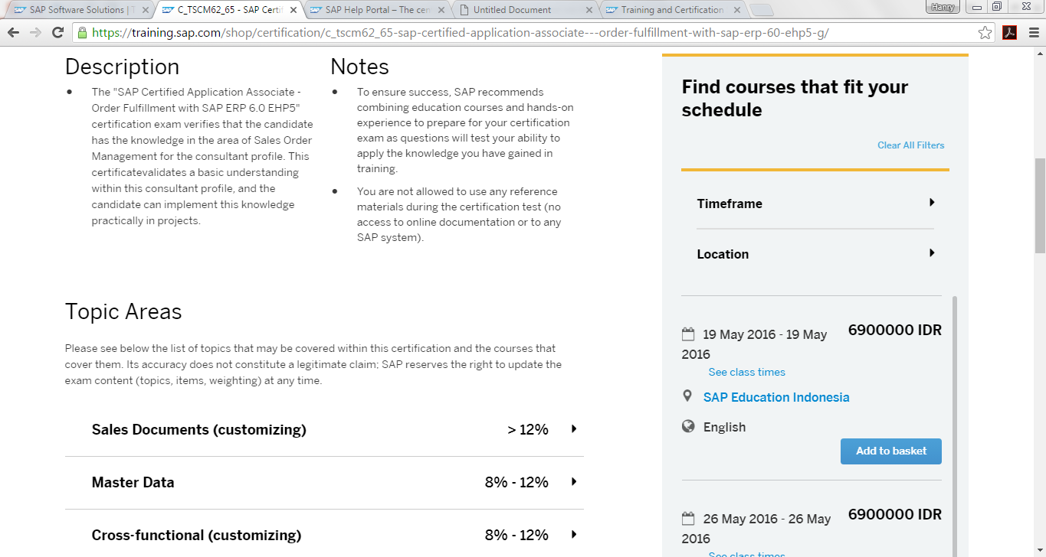
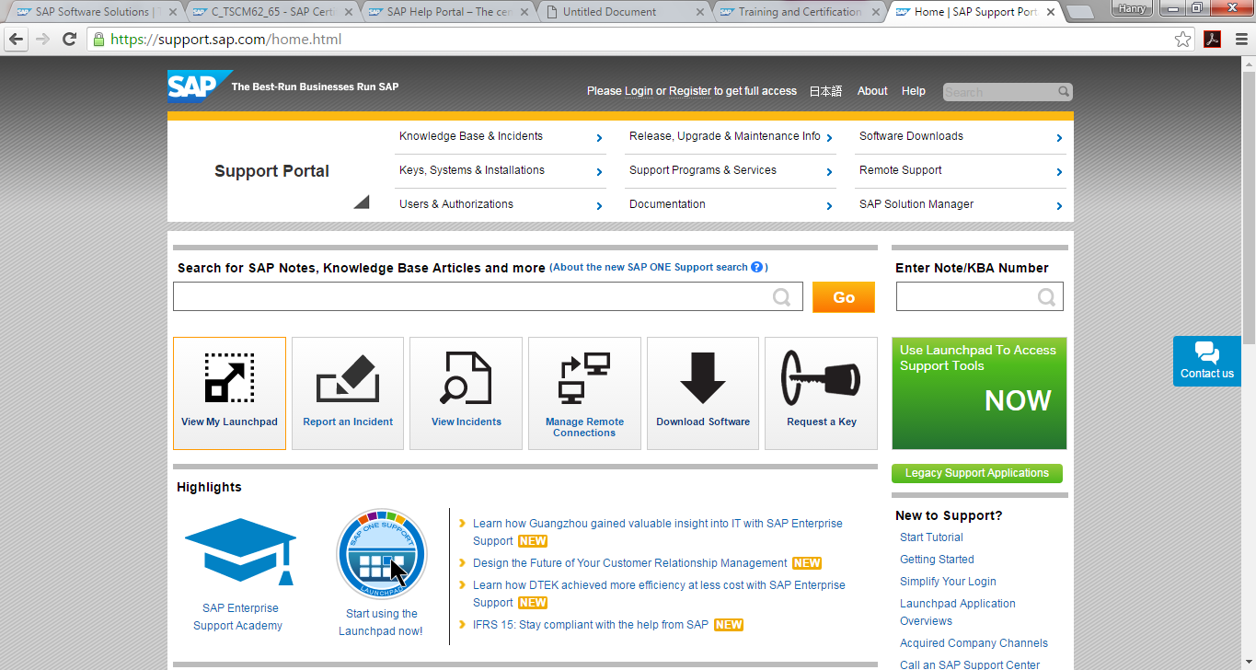
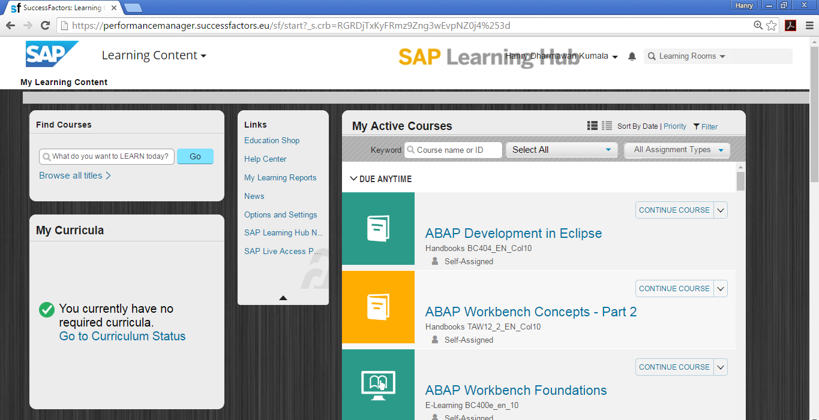
Where to Get Started with SAP Related Skills
SAP Classroom Training (Rp.6.9 mio – Rp.70 mio)
2. SAP UPP
(Purchased through University)
3. Learning Hub (Rp.4.2 mio)
4. SAP Marketplace
(Must Purchase SAP License or Passed Consultant Level Certification)
5. SAP Online Course and Certification (Rp.6 mio to Rp.70mio)

Slide 42



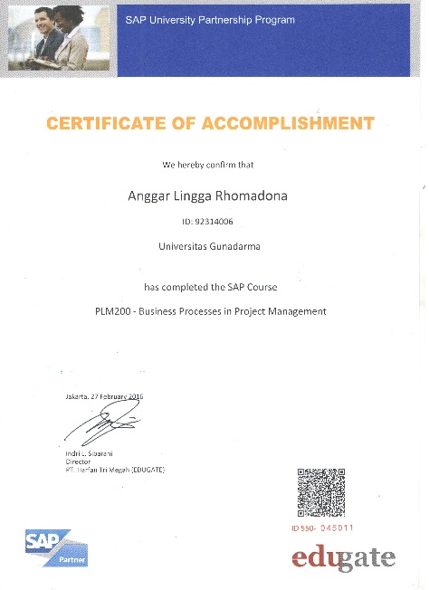
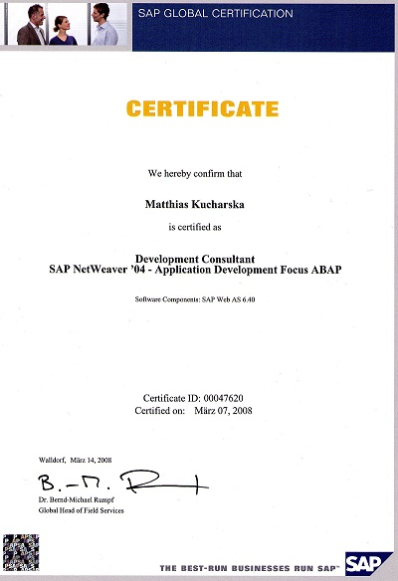
SAP Certification Path
Level 1 and Level 2 courses provide functionality knowledge needed by SAP users and key users
Level 3 courses provide SAP configuration knowledge needed by SAP consultants.
(Must pass a comprehensive examination)
(Level 1, 2 and 3 courses)
(Level 1 & 2 Courses)
SAMPLE ONLY
SAMPLE ONLY
SAMPLE ONLY

Slide 43
Strategies to Go Abroad.

Slide 44

Strategies to Go Abroad
Find good recruitment agents which concentrate on your specialties and focus on specific geographical areas you are interested in. They must also have a good reputation in the industry.
Involved in many different industries.
Make sure your CV contains detail info of what you have done or doing by explaining many of the business issues you experienced during your tenure, and how you helped solving those business issues.
Always update your SAP skill with the latest trend. Expand the SAP knowledge to other areas or functionalities.
Instead of mastering one specific module, master several modules so you can have more options when looking for jobs.

Slide 45
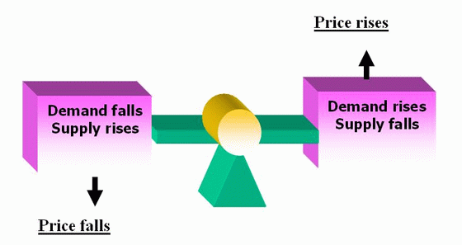
Don’t go abroad just for the sake of it.
High Skill -> Low Supply = High Pay
  Got hired because you have skills that is in demand
  Ex. Architects, information technology related professionals, doctors, researchers, etc.
Low Skill -> High Supply = Low Pay
  Got hired because willingness to be paid lower than standard
  Ex: Domestic workers (TKW), plantation labors, taxi drivers, garbage collectors, etc.

Slide 46
Conclusions.

Slide 47

Conclusions
The US and European market (Germany and France) are hot right now as these countries are going out of recessions. Countries that rely on natural resources are still struggling due to low natural resources prices. India is one of the hottest market in Asia taking over China’s position.
SAP still the largest global player in ERP market with more than 300,000 companies are running the SAP software.
To keep up with the market trends, SAP has been introducing new products. Most of the new products run with/on the SAP ERP ECC 6.0 software.

Slide 48

Conclusions
Keep on learning new things. It is a life-long process.
To be successful in entering the job market, fresh graduates must have the necessary skills and certifications to differentiate them with others. Differentiation is the key, especially in economic down turn.
Besides acquiring hard skills, soft skills are needed to impress recruiters. You must “show” your soft skills, not “tell” them.
Always do what you love, and love what you do. Never choose a career because of the monetary rewards only.

Slide 49

Conclusions

